Slide 1


UNIVERSITY OF THE PHILIPPINES DILIMAN
DEPARTMENT OF COMPUTER SCIENCE
Determining the Housing and Water Expenditure Based on Household-Level Data
Machine Learning Project
Cagulada, Roel Francos - WFX
Camingao, Ethan Joshua - WFY
Logroño, Brylle Joshua - WFY
Villos, Raymart Andrew - WFY
Presented to Sir Carlo Raquel
CS 180 Artificial Intelligence

Slide 2

Overview
Introduction
Objectives
Dataset
Methodology
Feature Selection
Training & Testing
Choosing Model
Results

Slide 3

Back to Overview
Introduction
Financial planning is key to achieving sustainable and good living conditions for families.
Some Filipinos still lack access to basic necessities like electricity and water. Policy makers need to make informed decisions to address this issue.
Source: Inquirer.net (March 2023)

Slide 4

One of the essential expenditures, particularly in our modern era, is housing, water, and electricity.
Objectives
Develop a regression model that can predict housing and water expenditure based on user information.
Achieving a model with low RMSE or R2 above 75%
Create a web application integrated with the model
Back to Overview

Slide 5

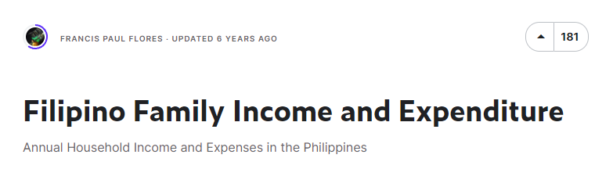
Dataset
Back to Overview
FIES Dataset
41,544 Rows; 60 Columns
Empty cells are found on irrelevant columns. No duplicate rows.
Most values are numerical
Relevant string variables will be subjected to Categorical Data Encoding (e.g., Regions; Type of Building/House; Main Source of Water Supply)
https://www.kaggle.com/datasets/grosvenpaul/family-income-and-expenditure

Slide 6
Dataset
Back to Overview
FIES Dataset
Columns to be used as variables (15):
Total Household Income;
Region;
Imputed House Rental Value;
Total Number of Family Members;
Type of Building/House;
House Floor Area (sqm);
House Age;
Number of Bedrooms;
Dug Well;
Number of CD/VCD/DVD;
Number of Component Stereo Set;
Number of Refrigerator/Freezer;
Number of Washing Machine;
Number of Airconditioner;
Number of Personal Computer

Slide 7

Methodology
Back to Overview
Cleaning Dataset | Handle Formatting - Typographical errors were corrected.
Feature Selection | Categorical Variables Encoding using Target Encoding. No initial features were highly correlated so none were dropped. Sequential Feature Selector from mlxtend library
Training & Testing | Split Training (70%) and Testing Data (30%)
Choosing the Model | Comparing metrics of 5 different regression models
Notes:
SequentialFeatureSelector from the scikit-learn library that implements a sequential feature selection algorithm. This module adds or removes (in our case, we will be looking at removing features) to form a feature subset in a greedy fashion. At each stage, this estimator chooses the best feature to add or remove based on the cross-validation score of an estimator.

Slide 8
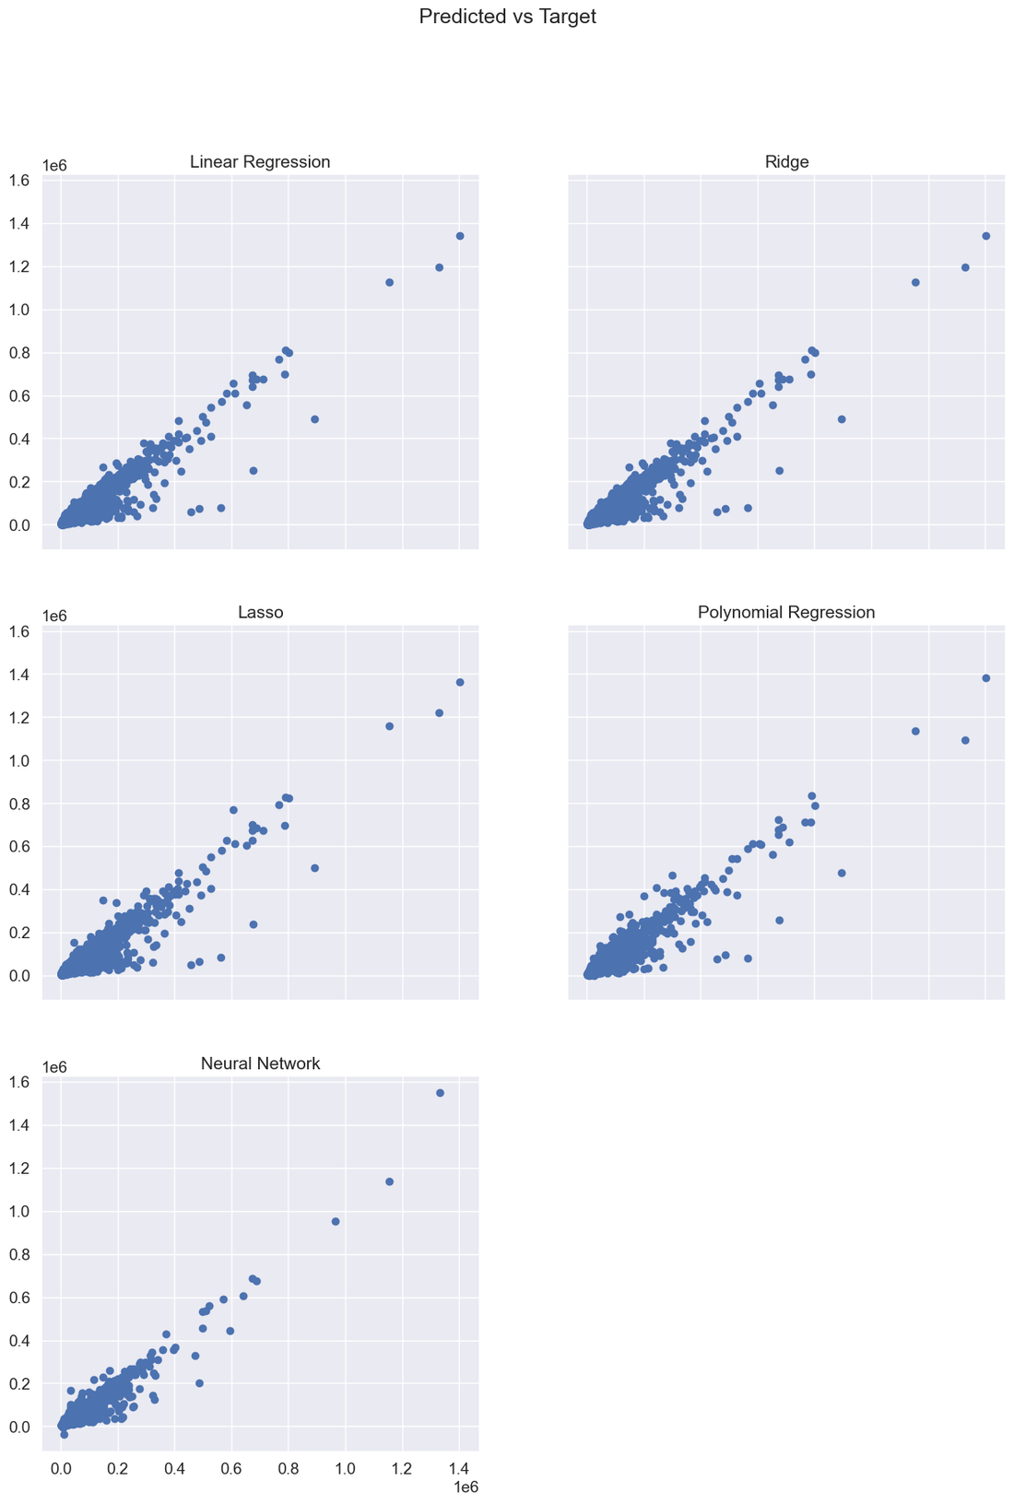
Methodology
Back to Overview
Linear Regression
Ridge
Lasso
Polynomial Regression
MSE: 281265826.2560366
MSE: 281265837.0484744310
MSE: 308853715.4868820310
MSE: 272514064.47355986
RMSE: 16770.981672401784
RMSE: 16770.9819941611
RMSE: 17574.2344210746
RMSE: 16508.000014343343
MAE: 7470.806807253993
MAE: 7470.8057127465
MAE: 7929.1892593778
MAE: 7088.7856923732525
R2: 0.9004809121373123
R2: 0.9004809083
R2: 0.8907196069
R2: 0.9035775106874353

Slide 9
Methodology
Back to Overview
Neural Network
The Neural Network model has two (2) hidden layers and uses adam as the optimizer and the loss function that the model seeks to minimize is the Mean Absolute Error (MAE).
The Neural Network model used 70% of the dataset for training, 15% for validation, and 15% for the testing.
MSE: 215029712.0000000000
RMSE: 14663.8916015625
MAE: 6443.5493164062

Slide 10
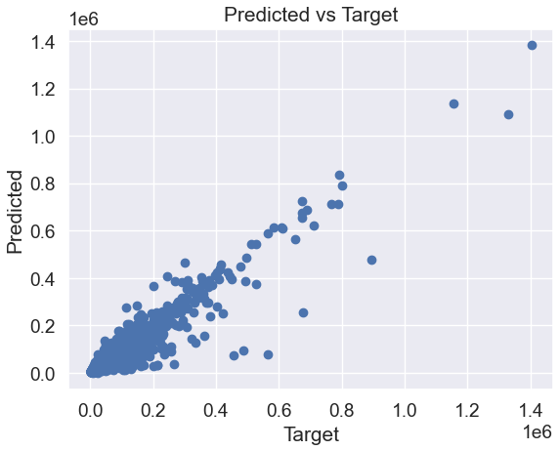
Back to Overview
Results
Polynomial Regression Model
model can capture non-linear relationships between variables by fitting a non-linear regression line
MSE: 272514064.47355986
RMSE: 16508.000014343343
MAE: 7088.7856923732525
R2: 0.9035775106874353

Slide 11

Let's head on to...
Web App
Demonstration
Locally deployed as of the moment.
Built with Flask and HTML

Slide 12
Let's head on to...
Demonstration
Studio A Corner Room 1 BR (240,000Php Rent)
Income = 480,000Php
Floor area = 30sqm
5 personal computers
Own Faucet
Expected: 280,000Php +

Slide 13

Back to Overview
Q&A Session
Thank you for listening!

